Slide 1
Caso Clinico
‘Uno strano caso di IBD’
Dott.ssa Samanta Romeo Tutor: Prof.ssa Livia Biancone
Scuola di specializzazione in Gastroenterologia
Università degli Studi di Roma “Tor Vergata”

Slide 2
Clinical Case
In September 2016, a 50-year-old man came to our IBD outpatient department because of rectal pain and lower bleeding, with a reported IBD diagnosis.
P.M.
50-year-old man, soldier
MSM, with a regular partner
no smoking, alcoholic or drugs habits
no comorbidity
no sexually transmitted infection (STI) story
no history of recent trips
no history of recent drug intake
no family history of IBD o GI disease

Slide 3
Clinical Case
April 2016:
anal pain
painful bowel movements
rectal bleeding
Proctological visit:
ANAL FISSURE
Topical hydrocortisone
☹

Slide 4
3
Clinical Case
June 2016:
NSAIDs abuse for rectal pain
Hospitalization because of upper GI bleeding
(Hb 6.7 g/dl)
EGDS: duodenal ulcer (Forrest III)
blood transfusion
iron therapy

Slide 5
Clinical Case
July 2016:
Dyschezia, hematochezia, rectal tenesmus
‘Proctitis Syndrome’
RSCS: ‘…fino al cieco; a livello del retto inferiore e dell’ano si repertava flogosi intensa con lesioni ulcerative ‘a carta geografica’ con margini rilevati; si eseguivano biopsie; voluminosa marisca emorroidaria flogosata.
(EI: reperto morfologici compatibili con diagnosi di malattia infiammatoria cronica intestinale in fase di severa attività; non evidenza di granulomi epitelioidi e fissurazioni-fistole)’.

Slide 6
5
Clinical Case
IBD diagnosis
☺
Topical beclomethasone dipropionate
1° gastroenterological visit (September 2016)
RSS with biopsy
Entero-MR
blood and fecal tests
tp: topic mesalazine
☺

Slide 7
6
Clinical Case
Entero-MR (20/10/2016):
‘… assenza di alterazioni a carico dell’intestino tenue’.
RSS (17.11.2016):
‘… fino a 25 cm dal m.a.; il retto distale, fino a circa 15 cm dal ma appariva estesamente ulcerato, alcune delle quali profonde ulcere a margini rilevati e di aumentata consistenza; la mucosa interposta tra le ulcerazioni appariva iperemica, friabile con scomparsa del reticolo sottomucoso; la mucosa della restante parte del colon esplorato appariva normale.
(EI: colite acuta e cronica priva di criteri morfologici di specificità; possibile diagnosi IBD, da valutare previa esclusione di coliti simili, come quella infettiva; CMV negativo)’.
CT abdomen and pelvis mdc
rectal EUS

Slide 8
7
Clinical Case
CT lower abdomen mdc (06.02.17):
‘…notevole ispessimento concentrico delle pareti del retto extraperitoneale, esteso da circa 5 cm dal m.a. per circa 8 cm, con linfonodi mesorettali del dtm di circa 10 mm ed irregolarità del tessuto adiposo mesorettale; il quadro non era univocamente riconducibile a patologia infiammatoria e si consigliava ulteriore indagine per escluderne la natura evolutiva…’
CEA, Ca 19.9, Ca 125 ndp.
Ab anti- HIV neg.
HOSPITALIZATION

Slide 9
Clinical Case
HOSPITALIZATION (08/02/2017 → 13/02/2017)
On examination, the patient appeared well.
BP 115/70 mmHg, HB 90 bpm, SPO2 100%, Temperature 37.6°C.
RDE : ‘presenza di marisca; in assenza di emorroidi esterne sanguinanti o ragadi anali; all’esplorazione presenza di area rilevata; presenza di sangue rosso vivo sul dito esploratore’.
The remainder of the examination was normal.
Blood test:
Mild anemia (Hb 11.2 g/dl, Ht 38.8 %, MCV 83.8 fl, MCH 24.2 pg)
CRP 29.5 mg/l; ESR 109 mm/h; FBG 522 mg/dl)
Screening for sexually transmitted infections:
Treponema Pallidum: TPHA reattivo, TPHA quantitativo pos (1:320); VDRL negativa; Ab Treponema Pallidum positivo; FTA-ABS quantitativa neg
Ab anti-HIV neg
Ab ANTI-HAV IgG > 60.00 UI/ml, IgM neg
Ab ANTI-HCV neg
Ab ANTI-HBc IgG/IgM pos, HBsAg neg, Ab ANTI-HBs > 1000.

Slide 10
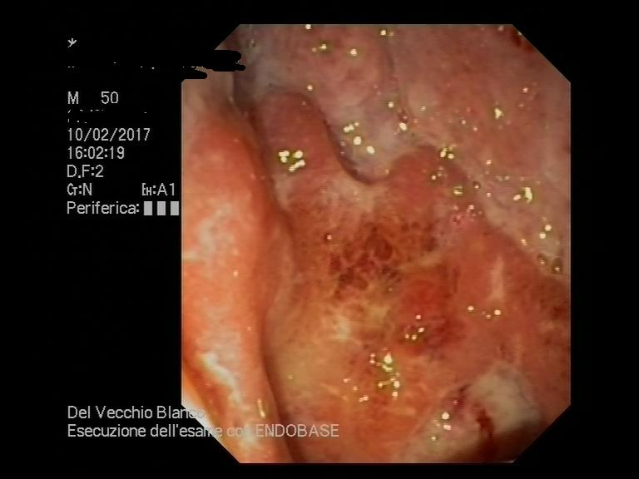
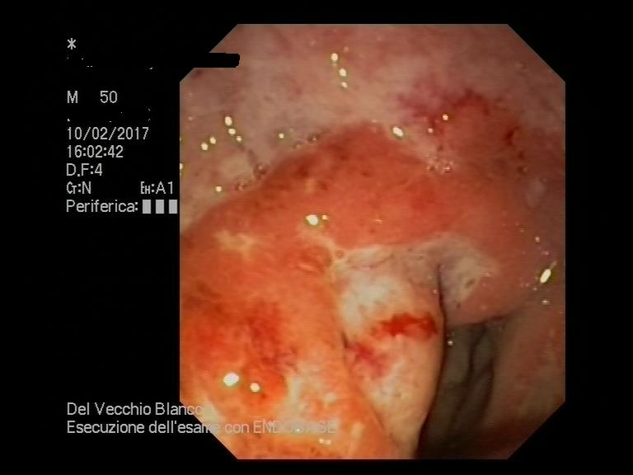
9
Clinical Case
Rectal EUS + FNA LN (22G needle) (10.02.17):
‘… ispessimento e marcato edema delle pareti del retto, con mucosa iperemica e facilmente sanguinante al contatto con lo strumento.
Alla visione ecografica presenza di multiple linfoadenomegalie perirettali e marcato ispessimento a manicotto della parete rettale con completo sovvertimento della stratificazione di parete’

Slide 11
10
Clinical Case
FNA LN: ‘scarsa quota di tessuto linfoide senza atipie (PAN-CK neg)’
FNA PARETE RETTO: ‘coaguli ematici inglobanti scarsissima quantità di tessuto fibroso e verosimile muscolare liscio (PAN-CK neg)’
EI BIOPSIE RETTO: ‘materiale come da fondo d’ulcera associato a tessuto flogistico di granulazione acuto e cronico (PAN-CK neg)’
‘La valutazione con la colorazione di Warthin Starry per la ricerca di microrganismi ha dato esito negativo’

Slide 12
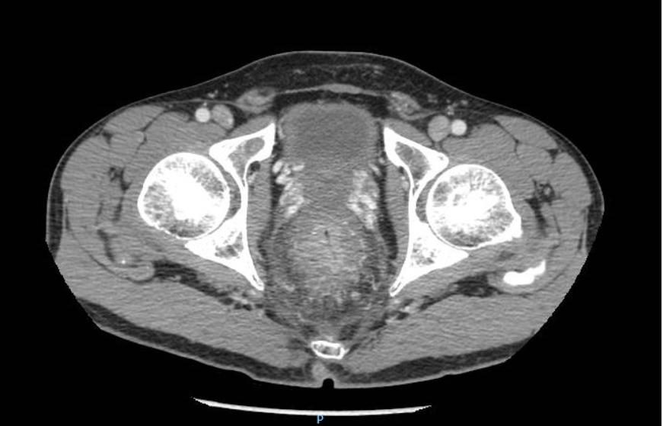
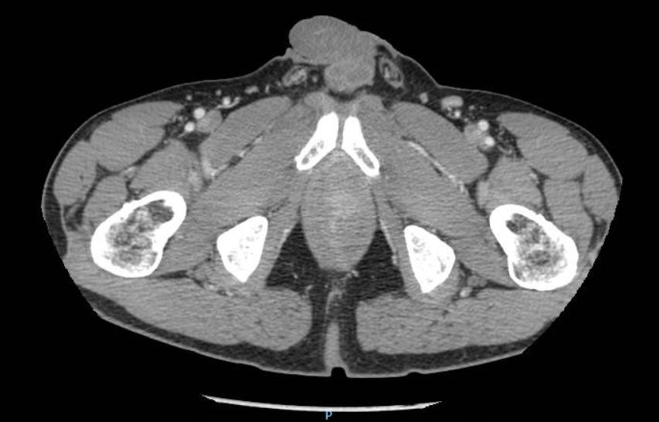
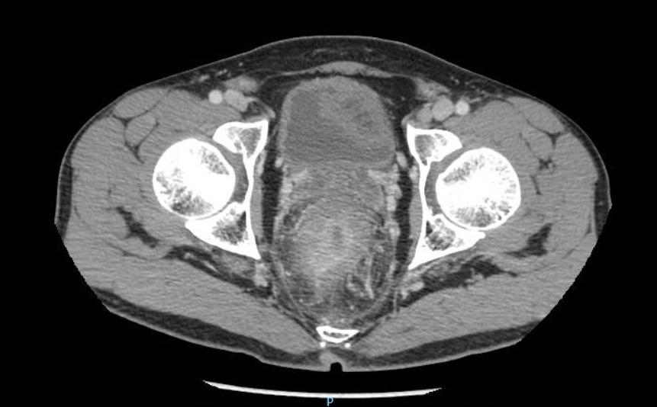
11
Clinical Case

Slide 13
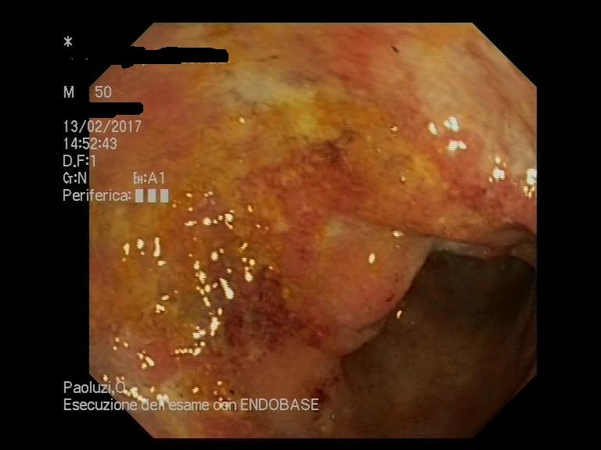
12
Clinical Case
Ileocolonoscopy (13.02.17):
‘… condotto fino ad esplorare gli ultimi cm di ileo terminale ed in condizione di adeguata preparazione intestinale, documentava ileo esente da alterazioni, colon con lume di calibro regolare; nel retto presenza di un tratto di 3-4 cm con mucosa iperemica ed edematosa; nei restanti segmenti colici esplorati mucosa esente da alterazioni.’

Slide 14
13
Clinical Case
During the hospitalization, empirical antibiotic therapy with ampicillin iv and anticoagulant therapy sc were administred.
DISCHARGE (13/02/2017)
Diagnosis:
‘ispessimento a manicotto della parete del retto in corso di definizione istologica’
INFECTIVE COUNSELING
(SEXUALLY TRANSMITTED INFECTIONS OUTPATIENTS DEPARTMENT)

Slide 15
14
Clinical Case
INFECTIVE COUNSELING (03/03/2017):
RECTAL SWABS
Chlamydia PCR
Neisseria Gonorrhoeae PCR
Neisseria Gonorrhoeae Coltura
HSV 1-2 PCR
POS
NEG
NEG
NEG
LYMPHOGRANULOMA VENEREUM (LGV)

Slide 16
15
Clinical Case
LYMPHOGRANULOMA VENEREUM (LGV)
Antibiotic therapy was administred:
Doxycycline 100 mg twice daily orally for 21 days
Azithromycin 500 mg twice daily orally for 21 days
☺
FOLLOW-UP
RECTAL SWABS (14/04/2017)
Chlamydia PCR NEGATIVE

Slide 17
16
Clinical Case
Clinical Diagnosis
Proctitis Syndrome
Ano-rectal diseases
Acute anal pain is almost always due to one of three things:
- an acutely thrombosed external hemorrhoid
- a perirectal abscess
- an anal fissure

Slide 18
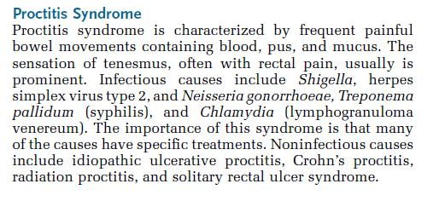
17
Clinical Case
Clinical Diagnosis

Slide 19
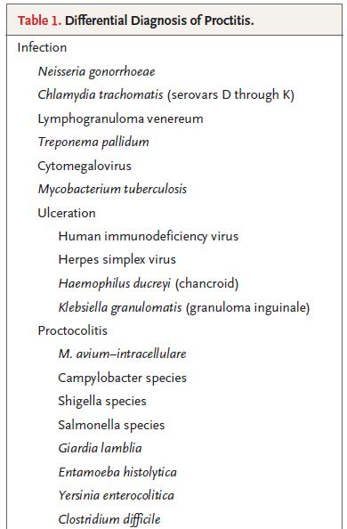
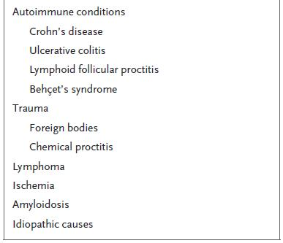
18
Clinical Case
On the basis of the patient’s sexual history, STI are more likely than IBD.
Zeidan J, NEJM 2016

Slide 20
Clinical Case
LYMPHOGRANULOMA VENEREUM (LGV)
Lymphogranuloma venereum is an emerging cause of proctitis in the population of MSM worldwide and is responsible for several outbreaks in Europe in the past 15 years.
LGV causes an isolated proctitis without lymphadenitis in 83% of cases that are acquired by anogenital contact.
The secondary stage (LGV proctitis) can mimic Crohn’s disease, both clinically (perianal fissures, fistulae and abscesses) and in the pathological substrate.
Zeidan J, NEJM 2016

Slide 21
20
Clinical Case
LYMPHOGRANULOMA VENEREUM (LGV)
Aetiology and transmission
Chlamydia trachomatis types L1, L2 and L3.
In contrast to serovars A-K, which remain confined to the mucosa, serovar L strains are invasive organisms that disseminate via underlying connective tissue and spread to regional lymph nodes.
LGV among MSM in Europe is caused in the majority of cases by the C. trachomatis biovar L2b
2013 European Guideline on the Management of Lymphogranuloma Venereum

Slide 22
21
Clinical Case
LYMPHOGRANULOMA VENEREUM (LGV)
Clinical features
Depending on the site of inoculation LGV can cause:
inguinal disease (usually after inoculation of the genitalia)
anorectal syndrome (usually after inoculation via the rectum)
Proctitis is the primary manifestation of infection (a few weeks of sexual contact).
It is characterised by severe symptoms of anorectal pain, haemopurulent discharge and bleeding per rectum, tenesmus and constipation (due to the mucosal and perirectal oedema).
2013 European Guideline on the Management of Lymphogranuloma Venereum

Slide 23
22
Clinical Case
LYMPHOGRANULOMA VENEREUM (LGV)
Clinical features
The disease course usually follows three separate stages.
Primary Lesion → small painless papule, pustule, small herpetiform ulcer (usually heals within one week and often remains unnoticed).
Second Stage/“inguinal stage” → begins 2 to 6 weeks after onset of primary lesion. Involves inguinal and/or femoral lymph nodes unilaterally (“buboes”). Some patients develop the ”groove sign”. Constitutional symptoms (low-grade fever, chills, malaise, myalgias and arthralgias) may present during this stage.
2013 European Guideline on the Management of Lymphogranuloma Venereum

Slide 24
23
Clinical Case
LYMPHOGRANULOMA VENEREUM (LGV)
Clinical features
Third Stage/ “anogenitorectal syndrome” → more often present in women (peri-rectal abscess, fistulas, strictures and stenosis of the rectum, possibly leading to “lymphorrhoids”, elephantiasis, esthiomene and frozen pelvis syndrome.
2013 European Guideline on the Management of Lymphogranuloma Venereum

Slide 25
24
Clinical Case
LYMPHOGRANULOMA VENEREUM (LGV)
Diagnosis
The diagnosis of LGV is confirmed by the detection of biovar-specific C. trachomatis DNA in:
ulcer material from primary anogenital lesions;
rectal specimens (in suspected cases of anorectal LGV);
anorectal swabs;
3) bubo aspirates (in suspected cases inguinal LGV).
2013 European Guideline on the Management of Lymphogranuloma Venereum

Slide 26
25
Clinical Case
LYMPHOGRANULOMA VENEREUM (LGV)
Diagnosis
Most modern laboratories follow a 2-step procedure:
First, a commercially available C. trachomatis NAAT test can be used to screen suspected samples.
Although commercially available tests are not approved for extragenital sites, a large body of literature supports the use of these tests for the detection of rectal chlamydial infections. (III, B)
If C. trachomatis is detected, LGV biovar-specific DNA needs to be detected from the same specimen. (III, B)
2013 European Guideline on the Management of Lymphogranuloma Venereum

Slide 27
26
Clinical Case
LYMPHOGRANULOMA VENEREUM (LGV)
Diagnosis
If molecular diagnostic tests are not available, a presumptive LGV diagnosis can be made using Chlamydia serological assays.
A high antibody titre in a patient with a clinical syndrome suggestive of LGV supports the diagnosis. (III, B)
The guidelines differ regarding the use of serology in diagnosis.
The Canadian guidelines state that serology is not recommended.
In contrast, the US, UK, and European guidelines indicate that LGV serology can be used to support the diagnosis of LGV in some contexts, when a laboratory cannot perform LGV genotyping.
2013 European Guideline on the Management of Lymphogranuloma Venereum
Workowski KA, Centers for Disease Control and Prevention STD treatment guidelines 2015

Slide 28
27
Clinical Case
LYMPHOGRANULOMA VENEREUM (LGV)
Management
It is recommended to screen all MSM who report receptive anal sexual practices in the previous 6 months for anorectal C. trachomatis infection.
There is a significant association between HIV and LGV (I, A)
Tests for STI, including HIV (if not already known HIV-pos), hepatitis B and hepatitis C should be offered before starting therapy. (III, C)
2013 European Guideline on the Management of Lymphogranuloma Venereum

Slide 29
28
Clinical Case
LYMPHOGRANULOMA VENEREUM (LGV)
Therapy
• First line: doxycycline 100 mg twice a day orally for 21 days. (IIb, B)
Second line: erythromycin 500 mg four times a day orally for 21 days. (III, B)
Azithromycin in single- or multiple-dose regimens has also been proposed, but evidence is lacking to recommend this drug currently. (IV, C)
2013 European Guideline on the Management of Lymphogranuloma Venereum

Slide 30
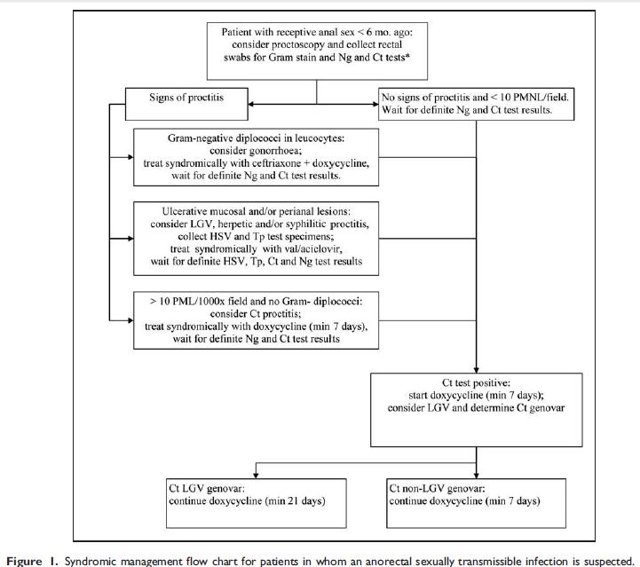
29
2013 European Guideline on the Management of proctitis, proctocolitis and enteritis caused by sexually transmissible pathogens

Slide 31
30
Clinical Case
LYMPHOGRANULOMA VENEREUM (LGV)
Information and follow-up
• Patients should be informed that LGV is an invasive bacterial infection that is sexually transmitted but curable with antibiotics.
Most of these complications are preventable if treatment is initiated in the early stages. (IV, C)
Symptoms should resolve within 1-2 weeks of commencing antibiotic therapy. (III, B)
Patients should abstain from any sexual contact until they have completed therapy. (IV, C)
• Screening for syphilis, C. trachomatis , N. gonorrhoeae, HIV, hepatitis B, and hepatitis C should be offered during a follow-up visit 3 months after an LGV diagnosis to exclude. (IV, C)
2013 European Guideline on the Management of Lymphogranuloma Venereum

