Slide 1
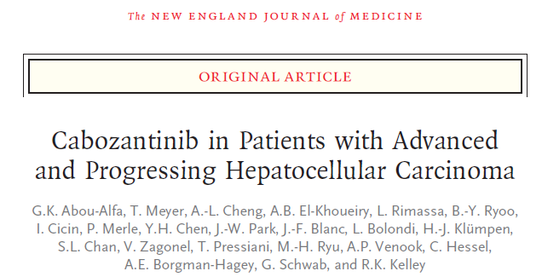
Norma Alfieri Journal Club 3/12/18
Università di Tor Vergata
N Engl J Med 2018;379:54-63.
Notes:
Buongiorno aa tutti l’articolo che presenterò oggi riguarda l’utilizzo del cabozantini nei paz affetti di HCCC in stadio avanzato che hanno mostrato progressione di malattia nel corso di terapie di I linea

Slide 2
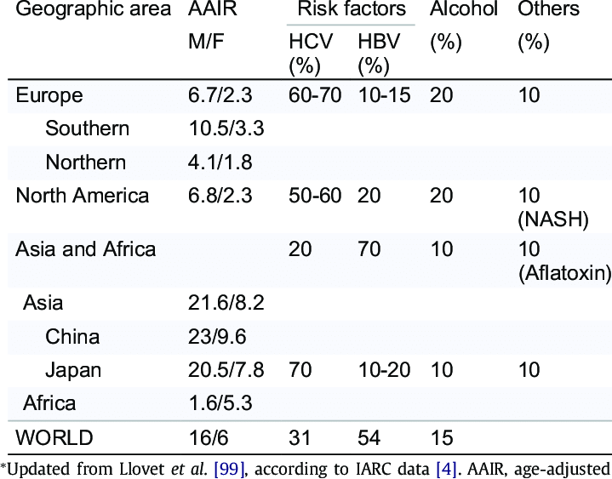
HCC
90% of primary liver cancers
Sixth most common cancer
worldwide
Globally 854,000 new cases
and 810,000 deaths per year
65,000 cases/year in Europe Journal of Hepatology 2018 vol. 69
Risk factor worldwide: 54% HBV infection, 31% HCV infection,
15% other causes (i.e. alcohol abuse, NASH)
In more than 70% of all HCC cases in advanced liver cirrhosis
Notes:
Frequenza degli Gli altri????
E’ uno dei tumori più frequenti in tutto il mondo
HCC incidence has been growing on a global scale. Between 1990 and 2015 newly diagnosed HCC cases increased by 75%, projections of cancer incidence estimate that, in 2030, liver cancer will be the third leading cause of cancer-related deaths
highest incidence rates in Asia orientale (more than 50% of the cases occurring in China) and sub-Saharan Africa, together accounting for about 85% of all cases.
In Europe, the incidence is lower with the exception of Southern Europe, where the incidence in men (10.5 age-standardised incidence rates per 100,000) is significantly higher due to the emergence of chronic liver disease, mainly chronic hepatitis C, but also to an increase in hepatitis B virus (HBV)-related HCC, particularly among immigrants from countries with endemic HBV infection, and the increasing incidence of non-alcoholic fatty liver disease
(NAFLD).
Projections of cancer incidence and deaths in the USA estimate that, in 2030, liver cancer will be the third leading cause of cancer-related deaths, surpassing breast, colorectal, and prostate cancers.
Approximately 90% of HCCs are associated with a known underlying aetiology3, most frequently chronic viral hepatitis, (B and C), alcohol intake and aflatoxin exposure.
In Africa and East Asia, the largest attributable fraction is caused by hepatitis B (60%), whereas in the Western world only 20% of cases can be attributed to HBV infection, while chronic hepatitis C appears to be the major risk factor.3
Worldwide, approximately 54% of cases can be attributed to HBV infection (which affects 400 million people globally) while 31% can be attributed to HCV infection (which affects 170 million people), leaving approximately 15% associated with other causes
Cirrhosis is an important risk factor for HCC. Overall, one-third of cirrhotic patients will develop HCC during their 1–8% of patients with cirrhosis develop HCC per year (e.g. 2% in HBV-infected cirrhotic patients and 3–8% in HCV-infected cirrhotic patients).16
L’HCC è riconosciuto come uno dei tumor maggiormente chemiorestenti, normali schemi di chemioterapia sistemica non sono indicati nel trattamento del HCC avanzato, per via della frequente sovrapposizione fra HCC e cirrosi che espone ad una aumentato rischio di tossicità legato all’alterazione del metabolismo dei suddetti famaci ed incrementare il rischio di gravi effetti collaterali (gravi infezioni sono letali nei cirrotici in quanto immunodepressi) e solo da pochi anni con l’introduzione della molecular targeted therapy si sono aperti orizzonti per la chemioterapia sistemica dei pazienti non eleggibili ad altra terapia
Advanced HCC (BCLC stage C): Patients with cancer-related symptoms (symptomatic tumours, ECOG 1-2), macrovascular invasion (either segmental or portal invasion) or extrahepatic spread (lymph node involvement or metastases) bear a poor prognosis, with expected median survival times of 6–8
months or 25% at one year

Slide 3
Journal of Hepatology 2018 vol. 69
Notes:
Il sistema di stadiazione utilizzato per l’HCC è il Barcelona clinic liver cancer staging system.
Si tratta di una classificazione che prende in considerazione le caratteristiche del tumore (dimensione, numero di noduli, invasione tumorale) associandole ad altri elementi che si sono rivelati essere importanti fattori prognostici:
il performance status del paziente (Eastern Cooperative Oncology Group, inteso come l’abilità del paziente di proveddere alle attività quotidiane, come la cura della propria persona, lavoro e mettività fisica basilare.)patient’s level of functioning in terms of their ability to care for themself, daily activity, and physical ability (walking, working, etc.).
La funzione epatica residua (espressa attraverso la classificazione di Chil-Pugh): una funzione epatica conservata (Child A) è il requisito necessario per tutte le indicazioni terapeutiche ad eccezione del trapianto.
Tale sistema inoltre associa a ciascuno stage di malattia la corretta strategia terapeutica.
Pazienti con una classe 0 o A ovvero con:
PS0: capacità di svolgere senza restrizioni tutte le attività.
Tumore singolo o multinodulare (fino a 3 noduli) ciascuno <3 cm
Le terapie raccomandate sono termo-ablazione con radiofrequenza, il trapianto e la resezione epatica;
In patients with very early stage HCC (BCLC-0) radiofrequency ablation in avourable locations can be adopted as first-line therapy even in surgical patients (evidence moderate; recommendation strong). For single HCCs ≤2 cm deeply/centrally located, radiofrequency ablation (RFA) offers competitive results with respect to LR
Thermal ablation with radiofrequency is the standard of care for patients with BCLC 0 and A tumours not suitable for surgery (evidence high; recommendation strong).
Thermal ablation in single tumours 2 to 3 cm in size is an alternative to surgical resection based on technical factors (location of the tumour), hepatic and extrahepatic patient conditions.
la resezione chirurgica è la terapia più indicata in pz non cirrotici con tumore >2 cm, candidati ottimali per chirurgia, l’outcome clinico (70% overall survival a 5 anni) in pz Optimal surgical candidate: LIVER FUNCTION ASSESSMENT: compensated Child-Pugh class A liver function with MELD score < 9, Valutazione dell’ipertensione portale presenza/ assenza, EXTENT OF HEPATECTOMY AND SURGICAL INVASIVNESS;
Trapianto CRITERI DI MILANO:
criteri di Milano (tumore unico di dimensioni ≥ 5 cm o ≤ 3 masse ciascuna di dimensione ≤ 3 cm, e nessuna invasione macrovascolare,); Up-to-seven” prevede che la somma delle dimensioni e del numero di masse tumorali non superi il valore complessivo di 7
Pazienti con classe B ovvero:
Child A
Multinodulare lesione >3 cm o > 3 noduli
La terapia indicata è TACE ovvero: infusione selettiva intra-arteriosa di agenti citotossici seguita da embolizzazione dei vasi arteriosi rifornenti il tumore.
(candidato ottimale child< B7, uni o pauci nodulare senza infiltrazione portale segmentale o principale).
Median survival of around 40 months in well-selected candidates with a state of the art technique and a super-selective approach
Per i pazienti con classe C o classi inferiori con progressione alla terapia loco-regionale o non eleggibili a trattamenti loco regionali (es BCLC B con invasione rami portali, trombosi portale):
Child A
Invasione vascolare o malattia extraepatica o nodale

Slide 4
BCLC stage C
Tumor with macrovascular invasion (i.e. segmental or portal invasion) or extrahepatic spread (i.e. lymph node involvement or metastases)
Preserved liver function
Impaired performance status with cancer-related symptoms
1. Restricted in physically strenuous activity but ambulatory and able to carry out work of a light or sedentary nature, e.g., light house work, office work
2. Capable of all selfcare but unable to carry out any work activities; up and about more than 50% of waking hours.
Expected median survival times of 6–8 months or 25% at one year.
Therapeutic indication: Sistemyc therapy
Notes:
Ad oggi solo 5% casi di HCC vengono diagnosticati in stadi precoci di malattia.
La classe BCLC-C della suddetta classificazione definisce la malattia in stato avanzato rappresentata da
Patients with cancer-related symptoms (symptomatic tumours, ECOG 1-2),
tumore localmente avanzato (macrovascular invasion (either segmental or portal invasion) or extrahepatic spread (lymph node involvement or metastases)
bear a poor prognosis with expected median survival times of 6–8 months or 25% at one year.
L’indicazione terapeutica per questi pazienti è rappresentata dalla terapia sistemica.

Slide 5
First-line therapies
HCC seems be chemo-resistant to the most common chemotherapies.
The problem of using chemotherapy in HCC stems from the coexistence of two diseases: cirrhosis can perturb the metabolism of chemotherapeutic drugs and enhance their toxicity.
Chemotherapy-related complications, such as systemic infections, are particularly severe in immunocompromised patients, like cirrhotic.
Until 2007 no systemic drug was recommended for patients with advanced tumours.
Molecular targeted therapies have changed the landscape of cancer management
Notes:
Tuttavia L’HCC è riconosciuto come uno dei tumor maggiormente chemiorestenti.
Trial con risultati negativi con doxorubicina, cisplatino, fluoro uracile.
Normali schemi di chemioterapia sistemica non sono indicati nel trattamento del HCC avanzato in parte per la frequente sovrapposizione fra HCC e cirrosi che espone ad una aumentato rischio di tossicità legato all’alterazione del metabolismo dei suddetti famaci ed incrementare il rischio di gravi effetti collaterali (gravi infezioni sono letali nei cirrotici in quanto immunodepressi).
Pertanto le chance terapeutiche di questi pazienti sono rimaste per molto tempo fortmente limitati ino all’inizione degli anni duemila quando lo sviluppo della molecular targerted theraty non ha aperto nuovi orizzonti per questi pazienti.

Slide 6
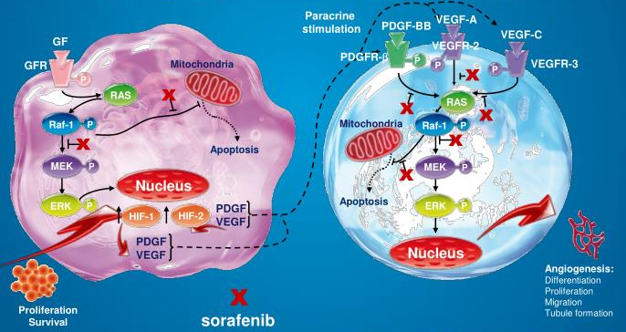
Sorafenib
400 mg per os twice daily.
Inhibitor of the serine–threonine kinases Raf-1 and B-Raf and the receptor tyrosine kinase activity of vascular endothelial growth factor receptors (VEGFRs) 1, 2, and 3 and platelet-derived growth factor receptor β (PDGFR-β).
Notes:
Fra 2007 2008 viene pubblicati primi risultati di trial clinici di fase II e successivamente III circa un nuovo farmaco a somministrazione orale, i sorafenib, nei pazienti affetti da HCC avanzato
SI tratta di un un inibitore di thy kin e recettori tir kinasici coinvolti nel signalli responsabile della promozione della porliferazione cellulare e delle neoangioigenesi che sembrava garantire un significativo incremente della sorpavvivenza media dei pz con HCC in stadio avanzato.
i dati circa multicenter, phase 3, double-blind, placebo-controlled trial su nuovo farmaco sorafenib che evidenziava un incremento nella sopravvivenza media dei paziente con HCC avanzato non suscettibili di trattamento.
(Median overall survival (OS) of patients in the sorafenib group was 10.7 months compared to 7.9 months in the placebo group (HR, 0.69; 95% CI 0.55–0.87; p = 0.00058), representing a 31% decrease in the relative risk of death.)
(Il sorafenib rappresenta il primo esepio di molecular targeted therapy applicata all’HCC sviluppata per antagonizzare selettivament specifici pathway molecolari coinvolti in particolare nei meccanismi neoangiogetici che caratterizzano l’HCC)
Sorafenib è un inibitore delle serina–threonine kinases Raf-1 and B-Raf e dei recettori tirosin chinasici del vascular endothelial growth factor receptors
(VEGFRs) 1, 2, and 3 and platelet-derived growth factor receptor β (PDGFR-β) inibendo pathway coinvolti nella differenziazione, proliferazione cellulare, migrazione cellulare e nella neoangiogenesi.

Slide 7
Sorafenib
Median overall survival (OS): Sorafenib 10.7 months vs placebo 7.9 months (HR, 0.69; 95% CI 0.55–0.87; p = 0.00058).
31% decrease in the relative risk of death.
First line standard systemic therapy for patients with well-preserved liver function (Child-Pugh A class) and with advanced tumours, BCLC-C, or tumours progressing on locoregional therapies.
Few data are available regarding use in Child-Pugh B/C patients or in elderly patients.
In retrospective studies for Sorafenib in Child-Pugh B patients:
Shorter overall survival vs compared with patients with Child-Pugh A.
Increased incidence of severe adverse events in Child-Pugh B patients, that led to dose reduction or discontinuation of treatment.
Notes:
La terapia con sorafenib ha mostrato un incremento della sopravvivenza mediana di 10,7 mesi ovvero una riduzione del rischio relativo di decesso del 30%, incremento del tempo di progressione.
Real-life data and reported OS for Barcelona Clinic Liver Cancer (BCLC) B patients of 15.6–20.1 months and for BCLC-C of 8.4–13.6 months
Attualmente riconosciuto come prima linea di terapia sistemica nei pazienti con HCC in stadio avanzato.
few data are available regarding its use in the presence of impaired liver function (Child-Pugh B/C) or in elderly patients. Regarding liver function, available data come from retrospective studies[14-18], that evaluated treatment with sorafenib in patients with liver function Child-Pugh B, showing shorter overall survival in these patients, compared with patients with Child-Pugh A. In addition, two studies[15-18] showed an increased incidence of severe adverse events in Child-Pugh B patients, that led to dose reduction or discontinuation of treatment.
Il sorafenib rappresenta il primo esepio di molecular targeted therapy applicata all’HCC sviluppata per antagonizzare selettivament specifici pathway molecolari coinvolti in particolare nei meccanismi neoangiogetici che caratterizzano l’HCC
In circa 10 anni ulteriori molecole sono state studiate come alternative al sorafenib nel trattamento del HCC avanzato:0
in I linea Recenti studi hanno evidenziato la non inferiorità rispetto al sorafenib di un ulteriore inibitore chinasico diretto contro i recettori del vascular endotelial grow factor e fibroblast growth factor receptor, platlet derivded grow factor,
Garantisce analoghi OS e riduzioni del rischio relativo nei pz con HCC avanzato senza invasione portale e notevole estensione di malattia-

Slide 8
Lenvatinib
Oral multi-kinase inhibitor that targets vascular endothelial growth factor receptor (VEGFR1-3); fibroblast growth factor receptor (FGFR1-4); platelet-derived growth factor receptor a (PDFGRa), RET, and KIT.
Journal of Hepatology 2018 vol. 69
Non-inferiority trial vs sorafenib:
overall survival Lenvatinib
3.6 months vs. sorafenib, 12.3.
Improved progression-free
survival: 7.4 months vs. 3.7
months on sorafenib.

Slide 9
Second-line Therapies
The clinical benefit of targeting vascular endothelial growth factor (VEGF) pathway has been modest, that suggests that inhibition of additional signaling pathways may improve efficacy.
Sorafenib has limitated effectiveness due to activation of compensatory pathway in HCC cells.
Regorafenib
An oral multi-kinase inhibitor that blocks the activity of protein kinases involved in angiogenesis, oncogenesis, and the tumour microenvironment (VEGFR-2, VEGFR-3, Tie-2, PDGFR, FGFR, mutant oncogenic kinases KIT, RET and B-RAF).
RESORCE trial, III phase on patients with advanced HCC progressed on Sorafenib: improved median OS (10.6 months vs 7.8 months on placebo; HR 0.63; 95% CI 0.50–0.79); p <0.0001).
Notes:
Tuttavia il benificio clinico
The hypoxic tumor environment generated by antiangiogenic treatment may also result in reactive resistance in which proliferative signaling and expression and secretion of proangiogenic factors are stimulated.
may also possibly select for cells with a higher propensity for invasiveness and metastases.
Efficacia di questi farmaci risulta essere ridotta dell’attivazione (spesso secondaria allo stimolo ipossico) di patway compensatori che garatiscono la ripresa della trasmissione del segnale porproliferativo, antiapoptotico e neoangiogenetico con conseguente progressione di malattia in corso di terapia e peggioramento della prognosi.
(107 of 263 (40.6%) patients demonstrated radiologic progression by the cut-off date).
Ulteriori sforzi si sono condotti per sviluppare risorse terapeutiche per la II linea di terapia, sviluppati in particolare per la gestione dei pazienti con progressione in corso di trattamento con farmaci di prima linea.
Regorafenib is an oral multikinase inhibitor with a structure very similar to that of sorafenib except for the addition of a fluorine atom in the center phenyl ring which confers a distinct biochemical and pharmacologic profile [64]. Its molecular targets include VEGFR-2, VEGFR-3, Tie-2, PDGFR, FGFR-1 fibroblast growth factor receptor, and the mutant oncogenic kinases KIT, RET and B-RAF [65].
Regorafenib is an oral multikinase inhibitor with a structure very similar to that of sorafenib in grado di inibire contemporanea di pathway diversi esso risulta essere un grado di inibire con maggior efficienza la neoangiogenesi indotta da tumore rispetto all’effetto della sola inibizione del pathway associato ai VEGFR
Tie-2 is predominantly expressed on endothelial cells and is a crucial regulator of angiogenesis, indispensible for the maturation of immature vessels. Thus, thanks to the combined blockage of VEGFR2 and Tie-2 signaling, regorafenib potentially inhibits tumor neoangiogenesis more potently than agents blocking VEGF signaling alone
he rationale for a dual VEGFR/MET blockade is supported by the consolidated evidence that resistance to VEGFR-targeted therapies may arise from the upregulation of alternative proangiogenic and proinvasive signaling pathways, including the MET pathway

Slide 10
Second-line Therapies: Cabozantinib
Hyperexpression of Tyr-Kinase receptor MET and AXL in patients progressed on I line-tp.
Multi-kinase inhibitor including VEGF receptors 1, 2, and 3, MET, and AXL, inhibits tumor growth in murine models of hepatocellular carcinoma.
Inhibitor of the migration and invasion of tumor cells by blocking the HIF- mediated MET signalling.
Notes:
Dai diversi studi condotti è emerso che tumori che presentavano progressione in corso di terapia di prima linea iperesprimevano of Tyr-Kinase receptor MET and AXL coinvolti nella cascata del segnale a valle dell’ hipoxia inducible factor che in condizioni di ipossia tissutale stimola la ripresa del segnale proangiogegnetico, della promozione della migrazione, dell’invasione cellulare e della metastatizzazione.
Pertanto è stato preso in considerazione come alternativa terapeutica il cabozantinib un farmaco già approvato per la terapia di carcinoma midollare della tiroide metastatico e come seconda linea nella terapia del carcinoma a cellule renali. Questo faramaco rappresenta un inibitore dei recettori tyr- chinasico con azione specifica contro VEGF receptors 1, 2, and 3, MET, and AXL, inibendo oltre l’angiogenesi, anche inhibits tumor growth, migration and invasion of tumor cells by blocking the HGF- mediated MET signalling.
Like VEGF, the receptor tyrosine kinases MET and AXL are induced by tumor hypoxia.12,13 MET and AXL play diverse roles in tumor biology, including promotion of the epithelial-to-mesenchymal transition, invasion, and metastasis,14,15 and both kinases are implicated in resistance to antiangiogenic
therapy.16-18 High expression of MET or AXL may be associated with poor prognosis in patients with hepatocellular carcinoma,19,20 and increased
MET expression or activation has been associated with previous sorafenib treatment in patients withhepatocellular carcinoma and with sorafenib resistance
in preclinical models
- Alfa HIF: alpha subunit of transcription factor hypoxia-inducible factor-1 (HIF-1), which is a heterodimer composed of an alpha and a beta subunit. HIF-1 functions as a master regulator of cellular and systemic homeostatic response to hypoxia by activating transcription of many genes, including those involved in energy metabolism, angiogenesis, apoptosis
-HGF: HEpatocity grow factor (protein that binds to the hepatocyte growth factor receptor to regulate cell growth, cell motility and morphogenesis in numerous cell and tissue types role in angiogenesis, tumorogenesis, and tissue regeneration
Sebbene the vascular endothelial growth factor (VEGF) pathway is an established therapeutic target in hepatocellular carcinoma, but the clinical benefit
from targeting this pathway has been modest.
La variabilità di risposta al sorafenib sembra essere correlata alla variabilità genetica ma soprattutto a meccanismi di resistenza acquisita. Infatti lo stimolo ipossico sembra essere coinvolto nell’up regulation di alcuni specifici pathway alternativi di neoangiogenesi e proliferazioen cellulare compensatori , che determinano l’acquisizione di una resistenza al sorafenib con progressione del tumore.
Gli sforzi della ricerca si sono quindi concentrati sul farmaci capaci di inibire molteplici differenti cascate del segnale contemporaneamente.
Ulteriori studi hanno permesso di individuare come predittore di prognosi infausta e come indicatore di resistenza al sorafenib con conseguente elevato rischio di progressione in corso di terapia, l’iperespressione dei recettori Tyr-k MET e AXL, promossa dallo stimolo ipossico.
Tali recettori sono coinvolti nei meccanismi di promozione dell’invasione locale e la disseminazione metastatica associandosi ad una prognosi peggiore.
Questo ha posto l’attenzione su un farmaco già approvato per la terapia di carcinoma midollare della tiroide metastatico e come seconda linea nella terapia del carcinoma a cellule renali , un altro inibitore chinasico che presenta azione specifica contro VEGF receptors 1, 2, and 3, MET, and AXL, inibendo oltre l’angiogenesi, anche inhibits tumor growth, migration and invasion of tumor cells by blocking the HGF- mediated MET signalling.
ll patients are initially treated with the drug; patients with an objective response continue therapy; patients who do not progress or experience excess toxicity within a prespecified "run-in" period are then randomized to continuing or discontinuing therapy in a double-blind, placebo controlled manner.

Slide 11
N Engl J Med 2018;379:54-63.
DOI: 10.1056/NEJMoa1717002
Notes:
Sulla base dell suddette premesse e dei risultati dei trial di fase II a partire dal settembre 2013 è stato condotto un studio randomizzato in doppio cieco al fine di valutare l’efficacia del caboztinib nel trattametno di pazienti con HCC avanzato già sottoposti a terapia di prima linea

Slide 12
Methods: Inclusion criteria
Age ≥ 18 years old on the day of consent
Capable of understanding and complying with the protocol requirements and signed informed consent
Histological or cytological diagnosis of HCC
Progression following sorafenib or at least 1 prior systemic treatment for HCC
Eastern Cooperative Oncology Group performance status (ECOG PS) of 0 or 1
Low Child-Pugh Score
Total bilirubin ≤ 2 mg/dL (≤ 34.2 μmol/L) within 7 days before randomization
Serum albumin ≥ 2.8 g/dL (≥ 28 g/L) within 7 days before randomization
Adequate renal function (Serum creatinine ≤ 1.5 ´ or calculated creatinine clearance ≥ 40 mL/min using the Cockcroft-Gault equation)
Notes:
Eligible patients had received previous treatment with sorafenib, had disease progression after at least one systemic treatment for hepatocellular carcinoma, and could have received up to two previous systemic regimens for advanced disease.
Patients had to have Child-Pugh class A liver function.
Randomization was stratified by etiologic factor (hepatitis B virus [HBV] with or without hepatitis C virus [HCV], HCV without HBV, or other);
geographic region (Asia or other);
and evidence of extrahepatic spread of disease,
macrovascular invasion, or both (yes or no)

Slide 13
Methods: Inclusion criteria
Adequate hematologic function (laboratory criteria within 7 days before randomization):
a. Absolute neutrophil count (ANC) ≥ 1200/mm3 (≥ 1.2 × 109/L)
b. Platelets ≥ 60,000/mm3 (≥ 60 × 109/L)
c. Hemoglobin ≥ 8 g/dL (≥ 80 g/L)
Alanine aminotransferase (ALT) and aspartate aminotransferase (AST) < 5.0 × ULN within 7 days before randomization
Hemoglobin A1c (HbA1c) ≤ 8% within 28 days before randomization ( or fasting serum glucose ≤ 160 mg/dL)
Antiviral therapy per local standard of care if active hepatitis virus (HBV) infection
Notes:
Eligible patients had received previous treatment with sorafenib, had disease progression after at least one systemic treatment for hepatocellular carcinoma, and could have received up to two previous systemic regimens for advanced disease.
Patients had to have Child-Pugh class A liver function.
Randomization was stratified by etiologic factor (hepatitis B virus [HBV] with or without hepatitis C virus [HCV], HCV without HBV, or other);
geographic region (Asia or other);
and evidence of extrahepatic spread of disease,
macrovascular invasion, or both (yes or no)

Slide 14
Methods: Exclusion criteria
Fibrolamellar carcinoma or mixed hepatocellular cholangiocarcinoma
Moderate or severe ascites
Receipt of more than 2 prior systemic therapies for advanced HCC.
Prior cabozantinib treatment
Concomitant cardiovascular disorders (Symptomatic congestive heart failure, unstable angina pectoris, or serious cardiac arrhythmias)
Uncontrolled hypertension BP > 150/100 mm despite optimal antihypertensive treatment
Subjects with untreated or incompletely treated varices with bleeding or high risk for bleeding.
Notes:
Fibrolamellar carcinoma or mixed hepatocellular cholangiocarcinoma
Receipt of more than 2 prior systemic therapies for advanced HCC. Additional prior systemic therapies used as adjuvant or local therapy were allowed.
3. Any type of anticancer agent (including investigational) within 2 weeks before randomization
4. Radiation therapy within 4 weeks (2 weeks for radiation for bone metastases) or radionuclide treatment (eg, I-
131 or Y-90) within 6 weeks of randomization (subject was excluded if there were any clinically relevant
ongoing complications from prior radiation therapy)
5. Prior cabozantinib treatment

Slide 15
Methods: Exclusion criteria
CNS metastases
Previously identified allergy or hypersensitivity to components of the study treatment formulations
Stroke (including TIA), myocardial infarction, or other ischemic event (within 6 months before randomization)
Thromboembolic event within 3 months before randomization (excluding portal vein trhrombosis)
Gastrointestinal disorders (i.e. concomitant GI Tumors, active peptic ulcer disease, bowel obstruction, intra-abdominal abscess etc.)
Major surgery within 2 months before randomization.
Active infection requiring systemic treatment (i.e. AIDS; hepatitis virus infection controlled with antiviral therapy were eligible)
Notes:
6. Known brain metastases or cranial epidural disease unless adequately treated with radiotherapy and/or
surgery (including radiosurgery) and stable for at least 3 months before randomization. Eligible subjects must
have been without corticosteroid treatment at the time of randomization.
7. Concomitant anticoagulation, at therapeutic doses, with anticoagulants such as warfarin or warfarin-related
agents, low molecular weight heparin (LMWH), thrombin or coagulation factor X (FXa) inhibitors, or
antiplatelet agents (eg, clopidogrel). Low dose aspirin for cardioprotection (per local applicable guidelines),
low-dose warfarin (≤ 1 mg/day), and low-dose LMWH were permitted.
8. The subject had uncontrolled, significant intercurrent or recent illness including, but not limited to, the
following conditions:
a. Cardiovascular disorders including
i. Symptomatic congestive heart failure, unstable angina pectoris, or serious cardiac arrhythmias
ii. Uncontrolled hypertension defined as sustained blood pressure (BP) > 150 mm Hg systolic BP (SBP),
or > 100 mm Hg diastolic BP (DBP) despite optimal antihypertensive treatment
iii. Stroke (including transient ischemic attack), myocardial infarction, or other ischemic event within
6 months before randomization
iv. Thromboembolic event within 3 months before randomization. Subjects with thromboses of
portal/hepatic vasculature attributed to underlying liver disease and/or liver tumor were eligible
b. Gastrointestinal (GI) disorders including those associated with a high risk of perforation or fistula
formation:
i. Tumors invading the GI tract, active peptic ulcer disease, inflammatory bowel disease (eg, Crohn’s
disease), diverticulitis, cholecystitis, symptomatic cholangitis or appendicitis, acute pancreatitis or
acute obstruction of the pancreatic duct or common bile duct, or gastric outlet obstruction
Abdominal fistula, GI perforation, bowel obstruction, intra-abdominal abscess within 6 months before
randomization
Note: Complete healing of an intra-abdominal abscess must have been confirmed prior to
randomization
c. Major surgery within 2 months before randomization. Complete healing from major surgery must have
occurred 1 month before randomization. Complete healing from minor surgery (eg, simple excision, tooth
extraction) must have occurred at least 7 days before randomization. Subjects with clinically relevant
complications from prior surgery were not eligible
d. Cavitating pulmonary lesion(s) or endobronchial disease
e. Lesion invading a major blood vessel including, but not limited to: inferior vena cava, pulmonary artery, or
aorta. Subjects with lesions invading the portal vasculature were eligible.
f. Clinically significant bleeding risk including the following within 3 months of randomization: hematuria,
hematemesis, hemoptysis of > 0.5 teaspoon (> 2.5 mL) of red blood, or other signs indicative of
pulmonary hemorrhage, or history of other significant bleeding if not due to reversible external factors
g. Other clinically significant disorders such as:
i. Active infection requiring systemic treatment, known infection with human immunodeficiency virus
(HIV), or known acquired immunodeficiency syndrome (AIDS)-related illness. Subjects with active
hepatitis virus infection controlled with antiviral therapy were eligible.
ii. Serious non-healing wound/ulcer/bone fracture
iii. Malabsorption syndrome
iv. Uncompensated/symptomatic hypothyroidism
v. Requirement for hemodialysis or peritoneal dialysis
vi. History of solid organ transplantation
9. Subjects with untreated or incompletely treated varices with bleeding or high risk for bleeding. Subjects
treated with adequate endoscopic therapy (in accordance with institutional standards) without any episodes
of recurrent GI bleeding requiring transfusion or hospitalization for at least 6 months prior to study entry were
eligible.
10. Moderate or severe ascites
11. Corrected QT interval calculated by the Fridericia formula (QTcF) > 500 ms within 7 days before randomization
Note: If the QTcF was > 500 ms in the first ECG, a total of 3 ECGs were to be performed. If the average of these
3 consecutive results for QTcF was ≤ 500 ms, the subject met eligibility in this regard.
12. Inability to swallow tablets
13. Previously identified allergy or hypersensitivity to components of the study treatment formulations
14. Pregnant or lactating females
15. Diagnosis of another malignancy within 2 years before randomization, except for superficial skin cancers, or
localized, low-grade tumors deemed cured and not treated with systemic therapy

Slide 16
Trial Design
773 patients from 95 sites in 19 countries were randomly assigned 2:1 between September 2013 and September 2017 to receive cabozantinib or placebo
Patients randomized recieved Cabozatinib 60 mg- tablet either Placebo tablet to be taken orally once per day
Tumors were assessed by computed tomography or magnetic resonance imaging at baseline and every 8 weeks after randomization
Radiographic assessments were performed until 8 weeks after radiographic progression or discontinuation of cabozantinib or placebo, whichever occurred later.
Tumor response and progression were assessed by the investigator according to Response Evaluation Criteria in Solid Tumors (RECIST).
Sample size of 760 patients, needed to provide the trial with 90% power to detect a hazard ratio for death of 0.76 favoring cabozantinib over placebo with a two-sided log-rank test at a 5% level of significance.
Notes:
Quindi fra il 06,13 e il 09,17 sono stati arruolati 773 pz in 95 centri (america, inghilterra, asia, europa) che sono stati randomizzati con uno schema 2:1 trail gruppo di intervento e quello di controllo.
Al fine di garantire a questo studio la capacità di individuare una riduzione del rischio relativo di morte per il cabozantini che fosse statisticamente sgnificativa.
purpose is to select an appropriate sample size in achieving a desired power for correctly detection of a pre-specified clinical meaningful difference at a given level of significance.
HR:
è la differenza fra due curve di sopravvivenza k-m, rapporto tra i tasso di rischio istantanei di un evento in due condizioni

Slide 17
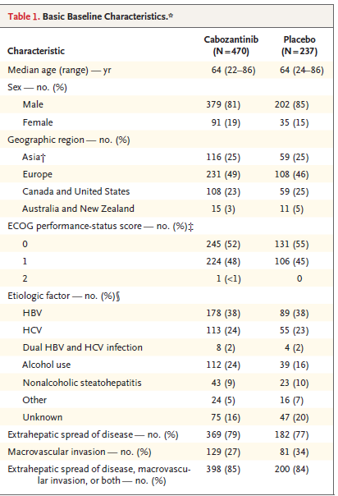
About 99% of randomized patients had received sorafenib
27% had received two previous systemic anticancer regimens for advanced disease (i.e. Regorafenib)
Notes:
Le caratteristiche della popolazione randomizzata al baseline erano For the cabozantinib vs placebo groups:
the median age was 64 years in both;
81% vs 85% were male;
Adeguata rappresentazione dei principali fattori di rischio
25% vs 25% were from Asia, 49% vs 46% were from Europe, and 23% vs 25% were from the United States and Canada;
Eastern Cooperative Oncology Group performance status was 0 for 52% vs 55% and 1 for 48% vs 45%;
Funzione epatica conservata
Tutte i maggiori fattori di rischio erano equamente rappresentate
Randomization was stratified by etiologic factors included HBV in 38% vs 38%, HCV in 24% vs 23%, and both in 2% vs 2%; and extrahepatic spread of disease (79% vs 77%), macrovascular invasion (27% vs 34%), or both were present in 85% vs 84%. geographic region (Asia or other);
All patients had received sorafenib, and 27% had received two previous systemic anticancer regimens for advanced disease.

Slide 18
End points
Primary end point:
overall survival, defined as the time from randomization to death from any cause
Secondary end points:
progression-free survival defined as the time from randomization to radiographic progression or death from any cause, whichever occurred first
objective response rate defined as the percentage of patients with a confirmed complete or partial response
Were planned up to three analyses when approximately 50%, 75%, and 100 of the expected deaths had occurred to asses the primary end points.
Notes:
Sono state programmate 3 analisi provvisorie in corso di follow-up al raggiungimento del 50%, 75% e 100% dei decessi previsti

Slide 19
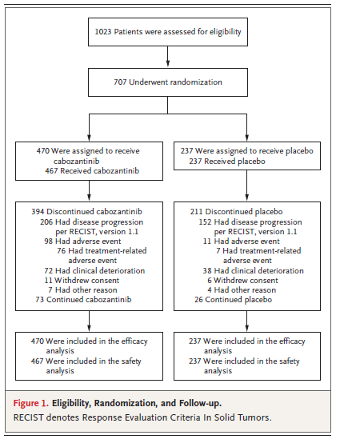
Results
The first interim analysis (1st of June 2016): HR for death 0,71 (p= 0,0041)
At second interim analysis (1st of June 2017) 707 patients had undergone randomization (470 cabozantinib, vs 237 to receive placebo)
These patients made up the intention-to-treat populations for the efficacy analyses.

Slide 20
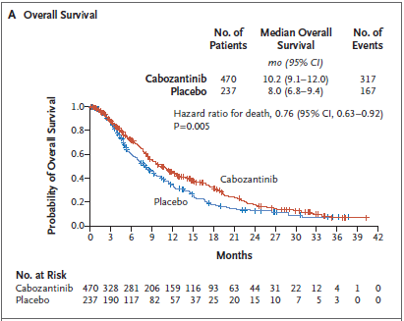
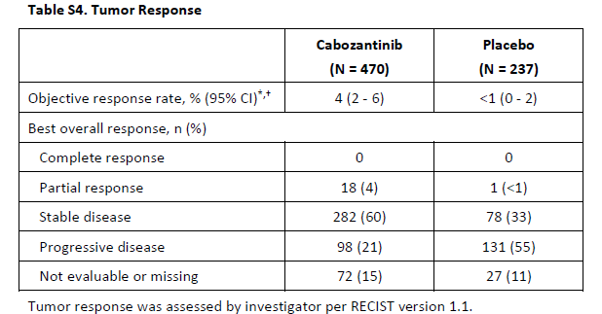
Results
Median overall survival: Cabozantinib 10.2 months (95% confidence interval [CI], 9.1 to 12.0) vs Placebo 8.0 months (95% CI, 6.8 to 9.4; p=0,005).
The stratified Hazard Ratio for death was 0.76 (95% CI, 0.63 to 0.92; p-value= 0,005)
Partial tumor response rate
4% in cabozantinib group vs
<1% in the placebo group (P = 0.009)
Notes:
Overall survival: showed a higher percentage of patients alive in the cabozantinib group than in the placebo group according to the Kaplan–Meier method at 6, 12, 18, and 24 months.

Slide 21
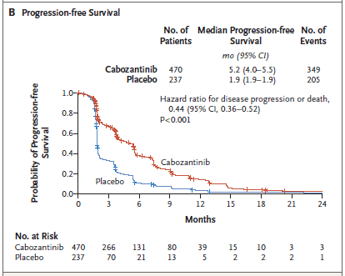
Results
Disease control : 64% (300 patients) in the cabozantinib group vs 33% (79 patients) in the placebo group (p=0,009).
The median progression-free survival according to RECIST, as assessed by the investigator, was 5.2 months (95% CI, 4.0 to 5.5) in the cabozantinib group and 1.9 months (95% CI, 1.9 to 1.9) in the placebo group.
The stratified hazard ratio for disease progression was 0.44 (95% CI, 0.36 to 0.52; P<0.001)

Slide 22
Results
Notes:
L’analisi della sopravvienza media e della sopravvivenza libera da progressione ha evidenziato una omogenea attività clinica del cabozantinib in pazienti con epatopatie ad eziologia deversa e con caratteristiche demografiche diverse.
Unica eccezione è repparesentasta dai dati riguardanti i pazienti affetti da HCV i quali un hazard ratio for death pari a 1,1 e per i pazienti arruolati in asia che non presentavano un miglioramento per i rischio relativo di morte (HR 1,01), non confermato tuttavia in pz di razza asiatica arruolati nel resto del mondo.
Tali evidenze suggeriscono che sia necessario approfondire tali differenze con studi ulteriori con specifica stratificazione per razza, regione e fattori eziologici dell’apeatopatia per riconoscere differenze fattori prognostici di efficacia del cabozantinib nelle diverse sottopolazione .
suggestion that future subgroup analyses stratified according to race, region, and etiologic factor are necessary to discern the relative prognostic and predictive effect of these subpopulations on cabozantinib treatment outcomes.
Infine è stato osservato che nei pazienti che erano stati sottoposti a precedente terapia con sorafenib presentavano OS 11,3 mesi vs 7,2 mesi con placebo con HR di 0,7; sopravvienza senza progressione 5,5 mesi vs 1,9 mesi con placebo ribadendo l’efficacia del cabozatinib su quelli che sono i meccanismi di resistenza al sorafenib.
In the subgroup of patients whose only previous systemic therapy was sorafenib, the median overall survival was 11.3 months with cabozantinib and 7.2 months with placebo (stratified hazard ratio for death, 0.70; 95% CI, 0.55 to 0.88), and the median progression-free survival was 5.5 months with cabozantinib and 1.9 months with placebo (stratified hazard ratio for disease progression or death, 0.40; 95% CI, 0.32 to 0.50) ribadendo l’efficacia del cabozatinib su quelli che sono i meccanismi di resistenza al sorafenib.

Slide 23
Safety
The rate of discontinuation of cabozantinib owing to adverse events related to the trial regimen was 16% (76 patients) in the cabozantinib group vs 3% (7 patients) in the placebo group.
Dose reductions occurred in 291 patients (62%) in the cabozantinib group vs 30 patients (13%) in the placebo group.
The median average daily dose was 35.8 mg for cabozantinib and 58.9 mg for placebo
Safety and the severity of adverse events was assessed by the investigator according to the Common Terminology Criteria for Adverse Events.
Toxicity grading: mild (Grade 1), moderate (Grade 2), severe (Grade 3), or life-threatening (Grade 4), death (Grade 5).
Notes:
Grade 1 Mild; asymptomatic or mild symptoms; clinical or diagnostic observations only; intervention not indicated.
Grade 2 Moderate; minimal, local or noninvasive intervention indicated; limiting age-appropriate instrumental ADL*.
Grade 3 Severe or medically significant but not immediately life-threatening; hospitalization or prolongation of hospitalization indicated; disabling; limiting self care ADL**.
Grade 4 Life-threatening consequences; urgent intervention indicated.
The most common grade 3 or 4 adverse events in the cabozantinib group were palmar– plantar erythrodysesthesia (17%, vs. 0% with placebo), hypertension (16% vs. 2%), increased aspartate aminotransferase level (12% vs. 7%), fatigue (10% vs. 4%), and diarrhea (10% vs. 2%)
Grade 5 Death related serious adverse event was defined as an adverse event of any grade that caused death, was life-threatening, resulted in hospitalization or prolongation of hospitalization, was deemed medically important, or resulted in disability or birth defect.

Slide 24
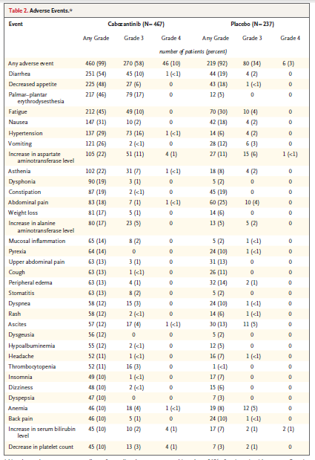
Adverse Events
Adverse events rate: 99% in the cabozantinib group vs in 92% in the placebo group
Grade 3-4 Adverse events : 68% in the cabozantinib group vs in 36% in the placebo group
Most common adverse events: Palmar-plantar erythrodysesthesia (17% vs 0%); Hypertension (16% vs 2%); Increased AST (12% vs 7%); Fatigue (10% vs 4%); Diarrhea (10% vs 2%).
Notes:
Grade 5 adverse events to be related to drugs: 6 patients in the cabozantinib group (one event each of hepatic failure, bronchoesophageal fistula, portal-vein thrombosis, upper gastrointestinal hemorrhage, pulmonary embolism, and the hepatorenal syndrome) vs 1 patient in the placebo group (hepatic failure).
Grade 3 Severe or medically significant but not immediately life-threatening; hospitalization or prolongation of hospitalization indicated; disabling; limiting self care ADL**.
Grade 4 Life-threatening consequences; urgent intervention indicated.
The most common grade 3 or 4 adverse events in the cabozantinib group were palmar– plantar erythrodysesthesia (17%, vs. 0% with placebo), hypertension (16% vs. 2%), increased aspartate aminotransferase level (12% vs. 7%), fatigue (10% vs. 4%), and diarrhea (10% vs. 2%)
Grade 5 related serious adverse event was defined as an adverse event of any grade that caused death, was life-threatening, resulted in hospitalization or prolongation of hospitalization, was deemed medically important, or resulted in disability or birth defect.
Grade 5 adverse events: 55 patients (12%) in the cabozantinib group and in 28 (12%) in the placebo group; commonly related to disease progression vs 6 in cabozatinib vs 1 in placebo were related to .

Slide 25
Adverse Events
Grade 5 adverse events occurring within 30 days after the last dose of cabozantinib or placebo were reported in 55 patients (12%) in the cabozantinib group and in 28 (12%) in the placebo group and were commonly related to disease progression.
Grade 5 adverse events to be related to drugs: 6 patients in the cabozantinib group (hepatic failure, bronchoesophageal fistula, portal-vein thrombosis, upper gastrointestinal hemorrhage, pulmonary embolism, and the hepato-renal syndrome) vs 1 patient in the placebo group (hepatic failure).

Slide 26
Discussion
Cabozantinib treatment significantly prolonged survival in patients with previously treated advanced hepatocellular carcinoma by improving overall survival and progression-free survival
Progression-free survival was assessed even across subgroups of patients with various etiologic factors and across subgroups with other baseline characteristics
In conclusion targeting multiple oncogenic and angiogenic pathways (i.e. by inhibiting MET and AXL in addition to VEGF receptors) we can provide additional efficacy in treatment of HCC and overcome resistance to agents that target VEGF receptors and
Notes:
I dati ottenuti ci mostrano che il C è efficace nel migliorare la prognosi dei paziente sottoposti a terapia incermentenado in modo statiscamente significativo la sopravvivenza media e la sopravvienza libera da porgressione di malattia.
Inoltre l’incermnto della spravvienza libera da progressione risulta un dato omogenao fra i diversi sottogruppo della popolazione indipendentemente dalla caratteristiche demografiche o dai fattori di rischio
Pertanto risulta vinciente la strategia terapautica basata sull’inibizione contemporanea di deverse vi di trasmissione del segnale che risulta efficiente anche nel superare il porbleme di resistenza al sorafenib.
This randomized, phase 3 trial showed that cabozantinib treatment significantly prolonged survival in patients with previously treated advanced hepatocellular carcinoma.
The median overall survival was 10.2 months with cabozantinib and 8.0 months with placebo, with a hazard ratio for death of 0.76.
Corresponding to this survival benefit, a longer duration of progressionfree survival was also observed: the median progression-
free survival was 5.2 months with cabozantinib and 1.9 months with placebo, with a hazard ratio for disease progression or death of
0.44.
By inhibiting MET and AXL in addition to VEGF receptors, cabozantinib targets multiple oncogenic and angiogenic pathways, which may provide additional efficacy and help overcome resistance to agents that target VEGF receptors.14-18,23,24 Cabozantinib also improved clinical outcomes in patients with advanced renal-cell carcinoma after previous antiangiogenic therapy, which further supports a role for targeting MET and AXL in overcoming resistance to
VEGF-pathway inhibition.

Slide 27
Discussion
Variable overall survival in subgroup analyses, with broader confidence intervals.
Hazard ratios for overall survival in subgroups can be affected by statistical variability from evaluation of smaller populations or imbalances in prognostic factors or subsequent anticancer therapies.
Further studies are required to asses the safety and the efficacy in patients with liver function impairment o poor performace status.
The most common adverse events were similar to those observed with other VEGF-receptor tyrosine kinase inhibitors
Rate of high-grade adverse events in the cabozantinib group was approximately twice vs the placebo group
Notes:
Subgroup analyses of progression-free survival suggested that cabozantinib had clinical activity across subgroups of patients with various
etiologic factors and across subgroups with other baseline characteristics.
Subgroup analyses of overall survival were more variable, with broader confidence intervals.
Subgroup analyses of overall survival were more variable, with broader confidence intervals.
Hazard ratios in subgroups can be affected by statistical variability from evaluation of smaller populations or imbalances in prognostic factors or subsequent anticancer therapies
It is noteworthy that in an analysis of overall survival, the hazard ratio for death was 0.69 in patients with disease caused by HBV and 1.11 in patients with HCV, and the hazard ratio for death was 0.86 in patients of Asian race but 1.01 in patients enrolled in Asia.
Further analyses are necessary to help understand these differences.
Ipotesi dell’aumentata prevalenza di HCV in asia è sbagliata perchè in asia è maggiormente prevalente lHBV
- Inoltre circa il 98% dei paz arrulati in questo studio presentava un funzione epatica residua ottimale (chil A) Because the survival of patients who have hepatocellular carcinoma with Child–Pugh liver disease of class B or worse is determined by liver failure, and it may be impossible to discern any effect of treatment on the cancer, it is justified to exclude these patients from pivotal clinical trials.
- Thus, as with all other agents approved for treatment of hepatocellular carcinoma, additional studies are required to confirm the safety and efficacy of cabozantinib in patients with more compromised liver function or poorer performance status.
The most common adverse events were similar to those observed with other VEGF-receptor tyrosine kinase inhibitors in patients with hepatocellular carcinoma.
Adverse events were managed with dose modifications and supportive care. Dose reductions occurred in the majority of patients, and the rate of discontinuation due to adverse events from cabozantinib or placebo was 16%. The, which was similar to the median dose (43 mg) received in a phase 3 trial involving patients with median average daily dose of cabozantinib was 35.8 mg advanced renal-cell carcinoma, which also showed therapeutic efficacy.

Slide 28
Notes:
Sulla base dell suddette premesse a partire dal settembre 2013 è stato condotto un studio randomizzato in doppio cieco al fine di valutare l’efficacia del caboztinib nel trattametno di pazienti con HCC avanzato già sottoposti a terapia di prima linea

